Slide 1
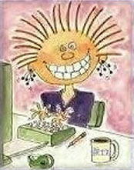
Surviving Middle School Madness
Dilene Pulsipher
ASB Advisor
Temecula Middle School
Tara Fry
ASB Advisor
James L. Day Middle School

Slide 2
First Things First!
Find a partner in crime!
Build a positive relationship with
your Administration & Staff
Build a relationship with your “Feeder” high school(s) & elementary schools
Work with advisors w/in & w/o of your District
Use REMIND.com & Social Media

Slide 3
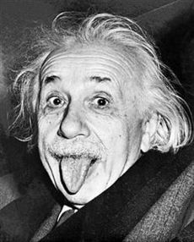
Cont.
Beg, borrow & steal ideas that
might work at your site.
“Smart people borrow…
genius’s steal” – T.S. Elliott
Develop relationships with vendors who will go above & beyond to help.
LEADERSHIP HANDBOOK for every ASB member
Stay ORGANIZED

Slide 4
Cont.
Mini-retreat
ASB Alumni run
Held before class schedule distribution
Work day
1st ASB meeting of the year held
Planned at the end-of-the previous school year

Slide 5
Starting the School Year off with a Bang!

Slide 6
Staff Buy-In
1st Staff Meeting of the year
Be brief
Simple competition with prizes
Welcome bags for new teachers & staff members

Slide 7
Fund-Raising Ideas “THINKING OUTSIDE THE BOX”
Spirit Packs
Adapt to your site’s demographics
ASB Activity Sticker
Discounted Yearbook
Spirit Shirt
Spirit Socks
Felt Pennant
Lanyard w/ plastic ID card holder
Water bottle

Slide 8
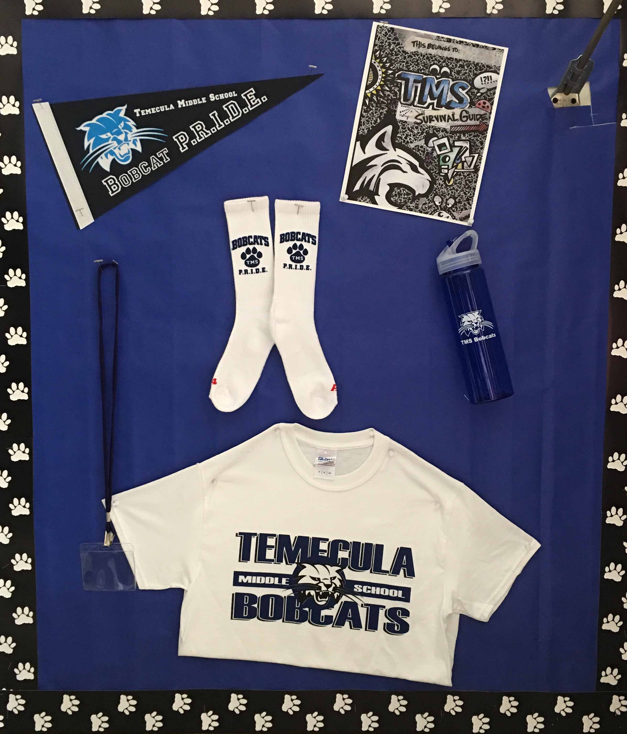

Slide 9
Fund Raising Ideas (cont.)
Color Run
Find a company you can trust & will work with your sites unique challenges
Run as an entire school
Extended Advisement
Non-toxic
Leaf Blowers
AnyThon
New company that will provide support for any type of “athon” you can think of
www.anython.com

Slide 11
Donations Drive “It’s harder to say no to the cute kid”
Student run
Students plan an “ATTACK” on the local businesses and franchises
Organization
Whiteboard
Script
Letter from Advisor explaining what the donated items will be used for
Letter from District for tax purposes.

Slide 12
Leadership Conferences
High Schools
Ask your high school ASB Director to help
CADA
Look for regional and area conferences
CARE Conference
Regional Conferences
CASL
Area conferences & Summer Camp

Slide 14
Elementary Leadership Conferences
Have your ASB students create a mini-conference for “feeder” elementary schools in your district or outlining districts
1 ½ - 2 hours MAX
Leadership Rotations
Student created Powerpoint Presentation on Leadership.

Slide 15
August
1st Day
ASB Students wear their shirts & greet students as they come onto campus
Welcome Party/Dance
6th grade only
Spirit Fridays!
Grade level shirts
Club Wednesdays
Students wear club shirts

Slide 17
September
Donations Drive
Fund-raiser
Because Nice Matters Week

Slide 19
October
Pink Day
Red Ribbon Week
“Feeder” High School(s) Homecoming

Slide 21
Getting Over the Mid-Year Slump!
Just when you thought you could breathe!

Slide 22
November
Canned Food Drive
THE HUNGER GAMES
Frozen Turkey Bowling
Day of Gratitude
National Donut Day

Slide 24
December
Holiday Spirit Week
Pick a theme and have a blast!
Star Wars
Frozen
Elf
Reindeer Races
Polar Express
Wrap a Teacher

Slide 27
January
Talent Show
Student run
Involve multiple clubs on campus
Closing Number
Spirit Week
Pick a theme

Slide 29
February
Random Acts of Kindness Calendar
National Counselor Appreciation Week
College Awareness Month
Super Bowl Friday
Red Day!
Valentine’s Grams

Slide 31
March
Dodgeball tournament
Color Wars Grade level competition
Easter Egg Hunt on Campus
Golden Egg

Slide 33
Ending the Year on Top!

Slide 34
April
“Smarty Pants” or “GENIUS” Day
To kick off CAASPP Testing
All students get Smarties
Posters for CAASPP Testing
Select new ASB members for the next school year
Administrative Assistance Appreciation Day

Slide 35
May
6th Grade Orientation
Teacher Appreciation Week
Principal Appreciation Day
Order supplies for Spirit Packs & ASB
Canned Food Drive
The Great Middle School Food Fight

Slide 37
TMS Teacher Appreciation Week
Monday, May 4th – Wear your Favorite Teacher’s color (Look for sign on Teacher’s whiteboard for information)
Tuesday, May 5th – Bring a special note, poem or card for your teacher
Wednesday, May 6th – Bring your teacher a flower
Thursday, May 7th – Bring your teacher a school supply
Friday, May 8th – Bring your teacher their favorite candy bar (Look for sign on Teacher’s whiteboard for information)

Slide 38
June
Outgoing ASB members plan MINI-Retreat for August
Send Leadership Handbook to be printed & bound
Invite new 6th Grade Level Representatives for a quick 45 minute meet & greet!
ASB Party!

Slide 39
You did it! You’re completely sane, like us!

